Slide 1
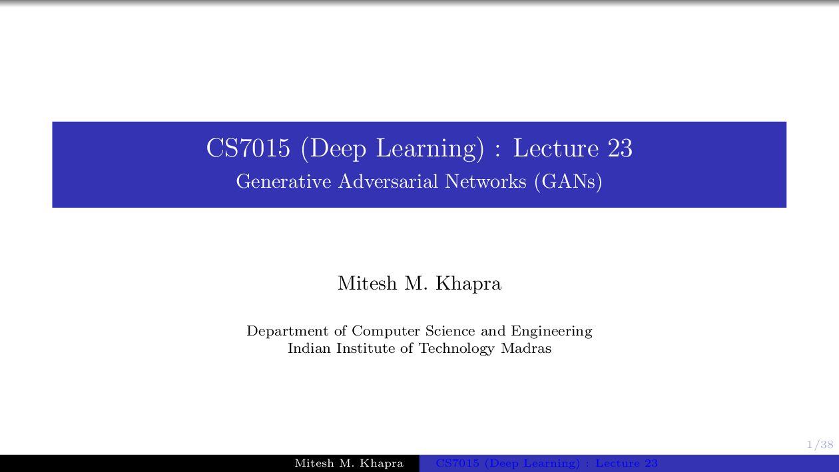


Slide 2
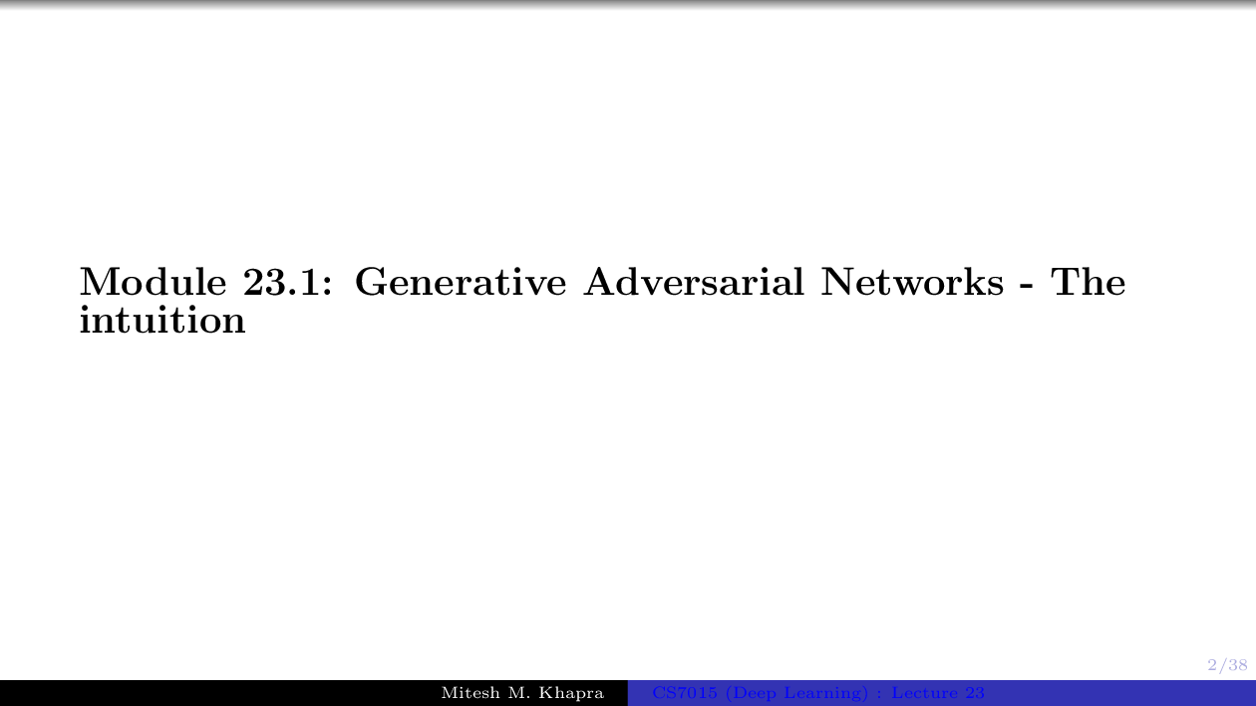

Slide 3
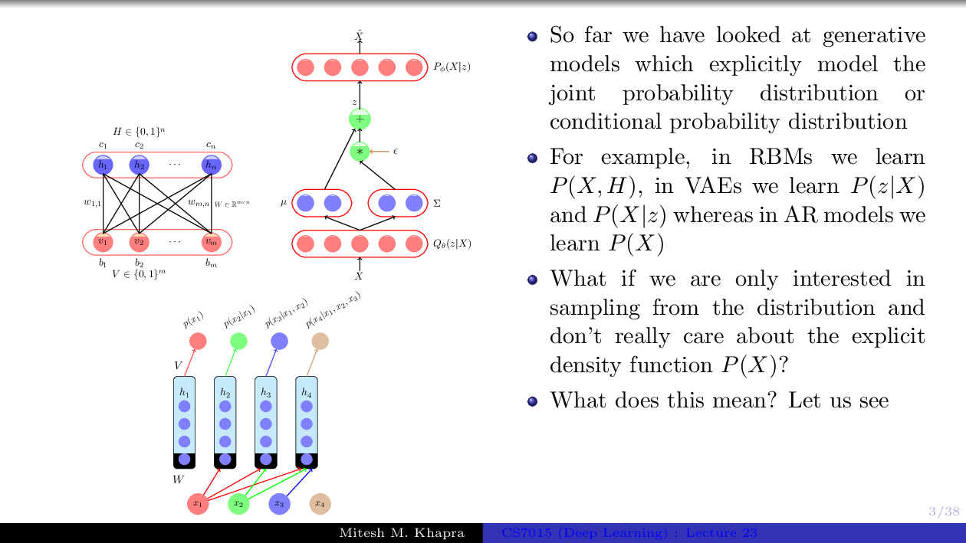

Slide 4
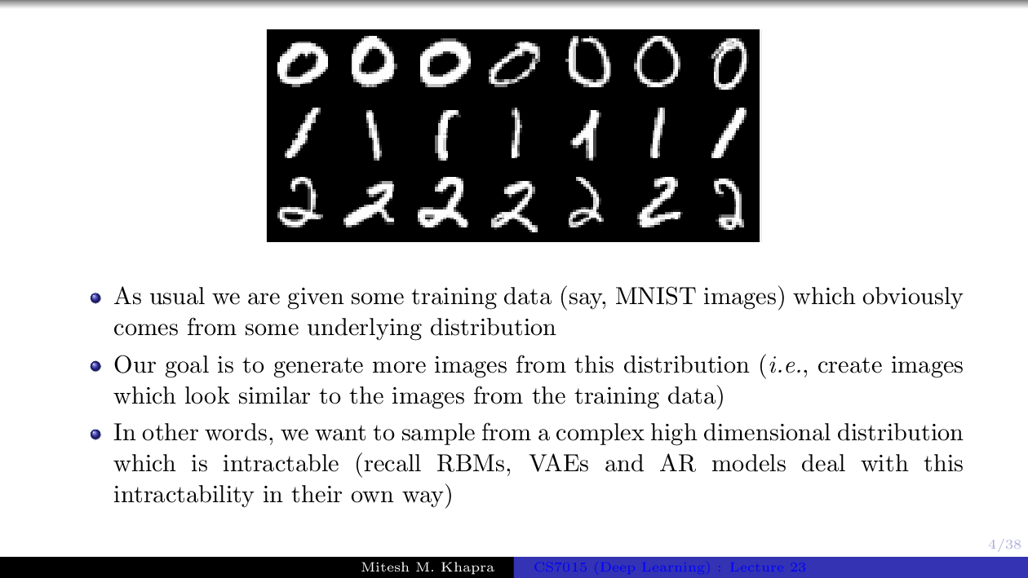

Slide 5
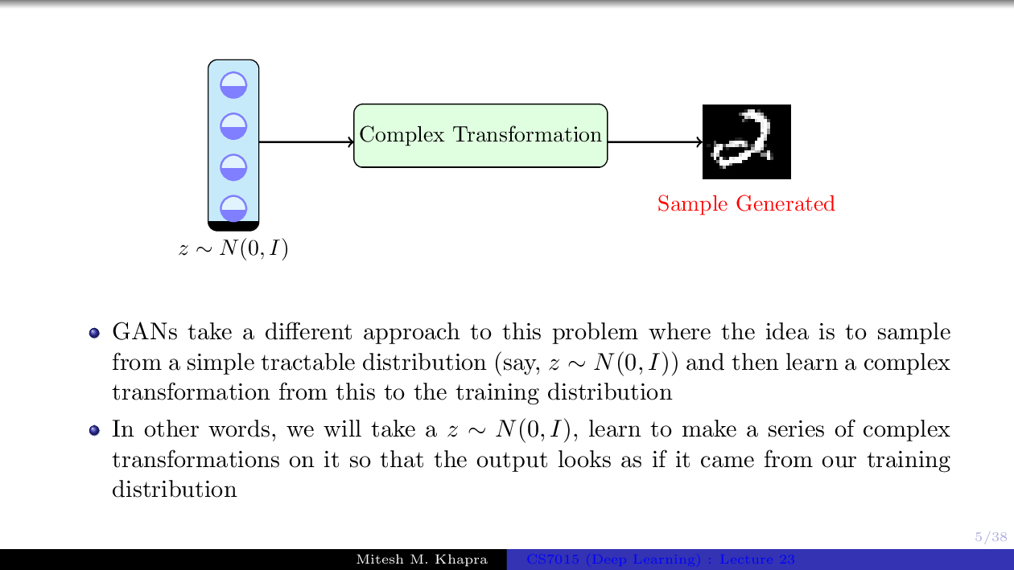

Slide 6
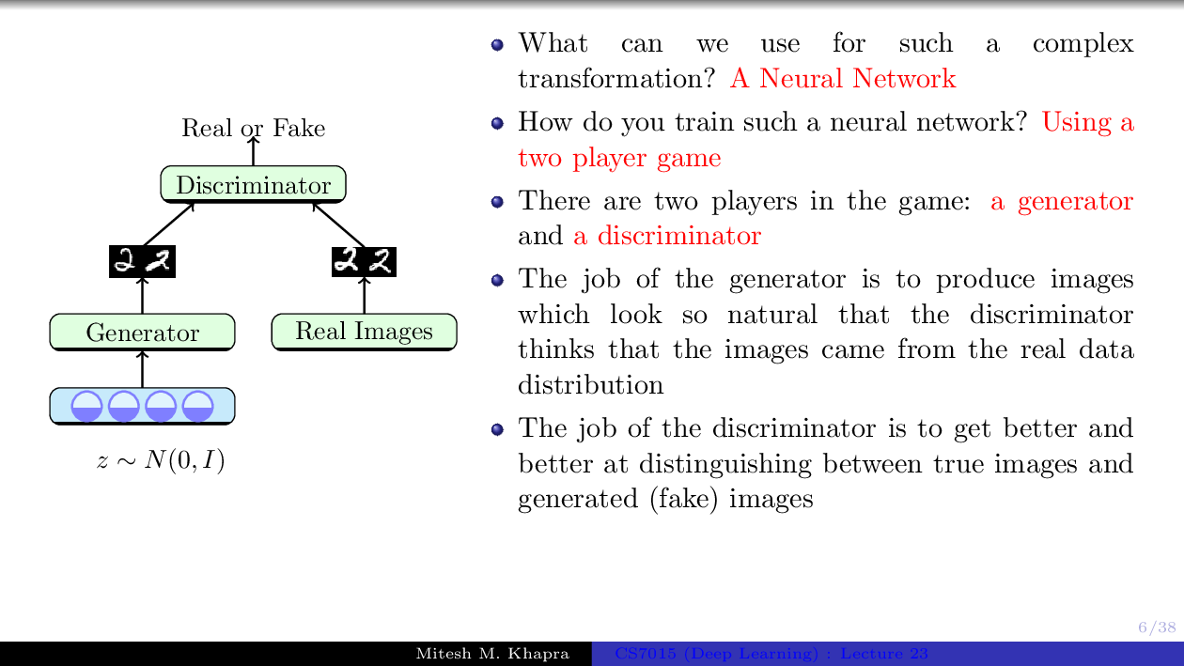

Slide 7
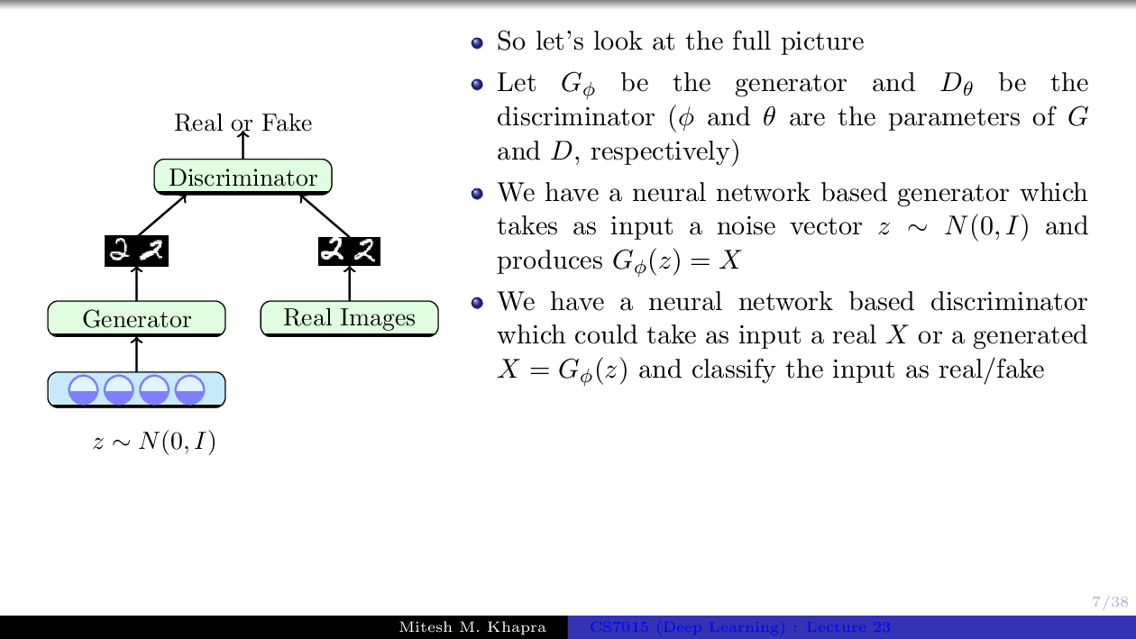

Slide 8
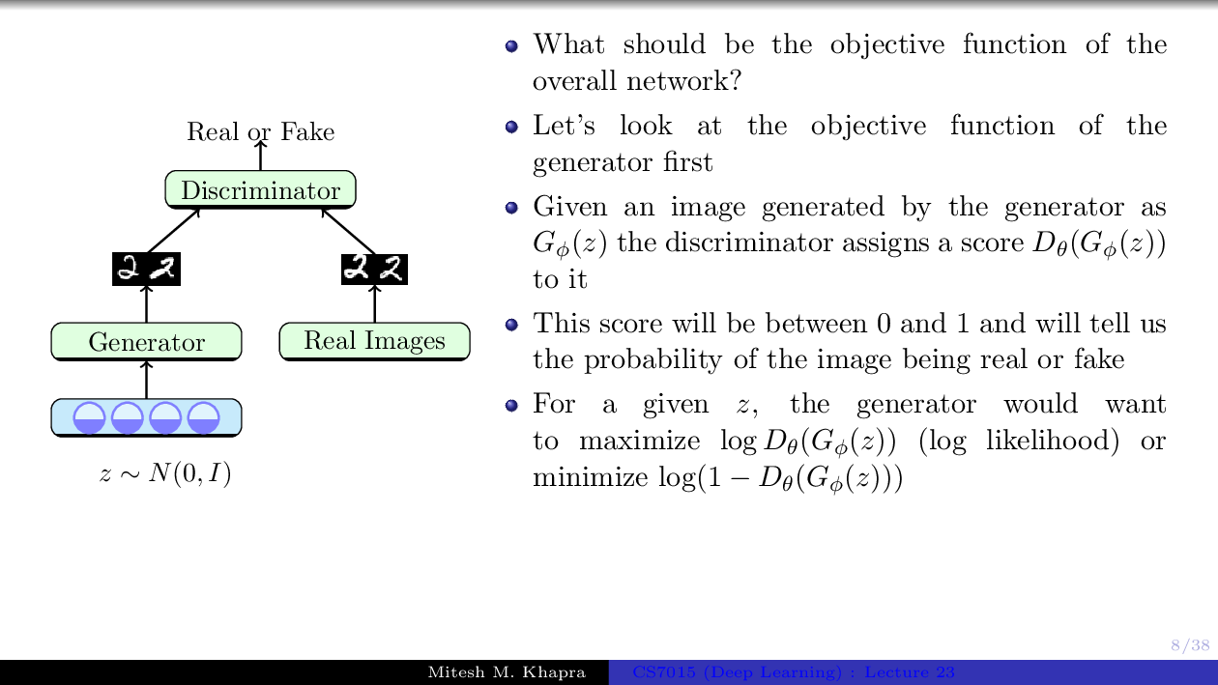

Slide 9
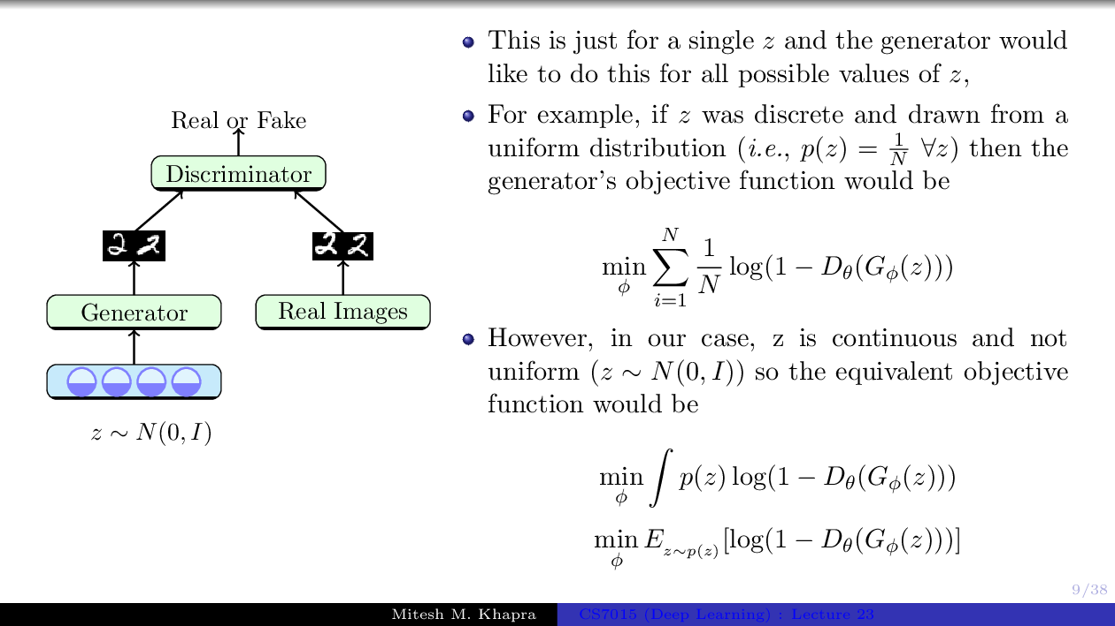

Slide 10
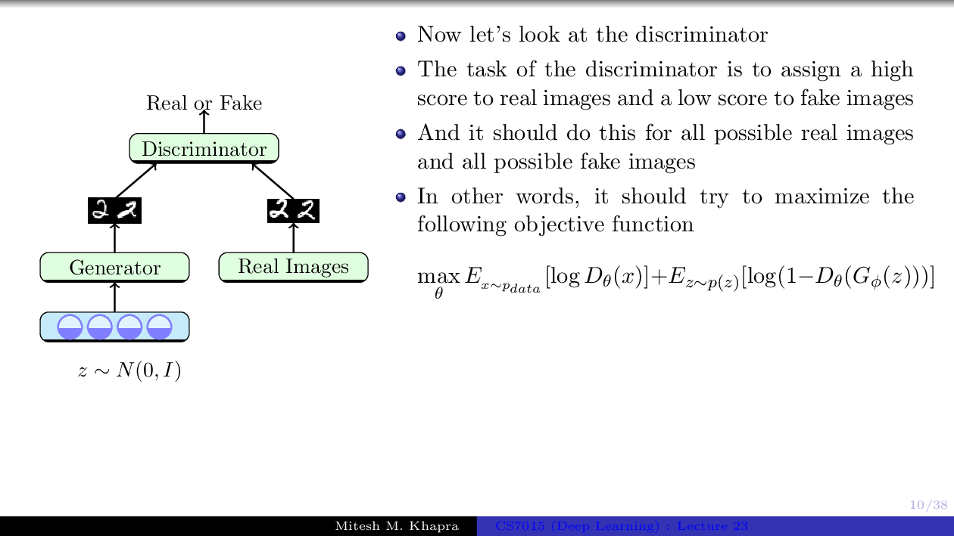

Slide 11
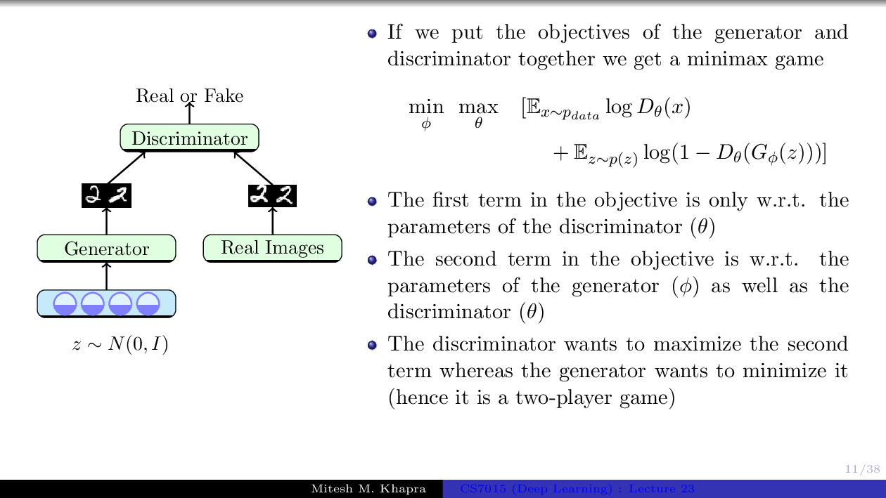

Slide 12
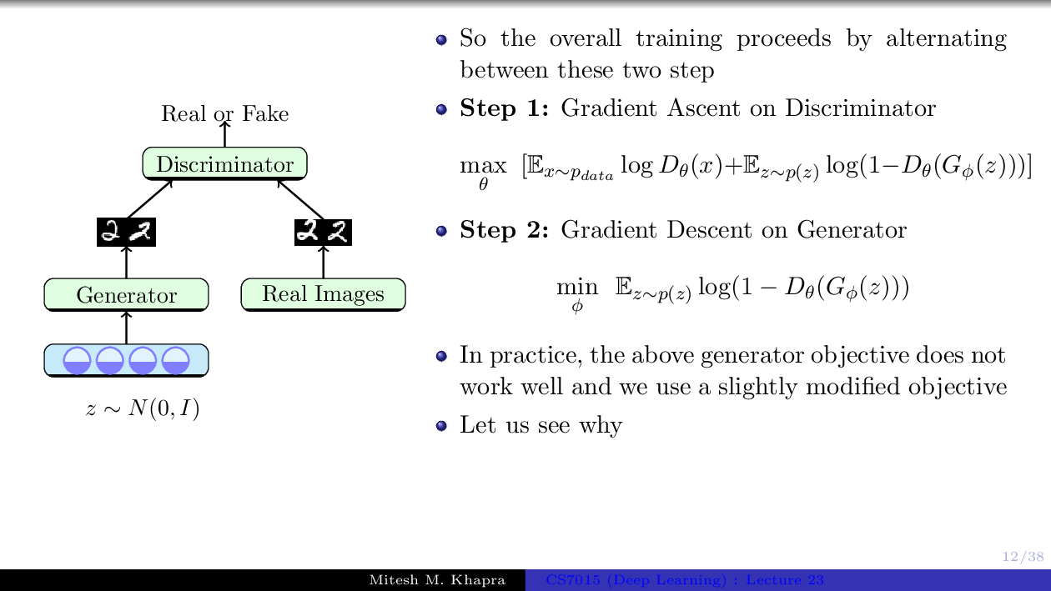

Slide 13
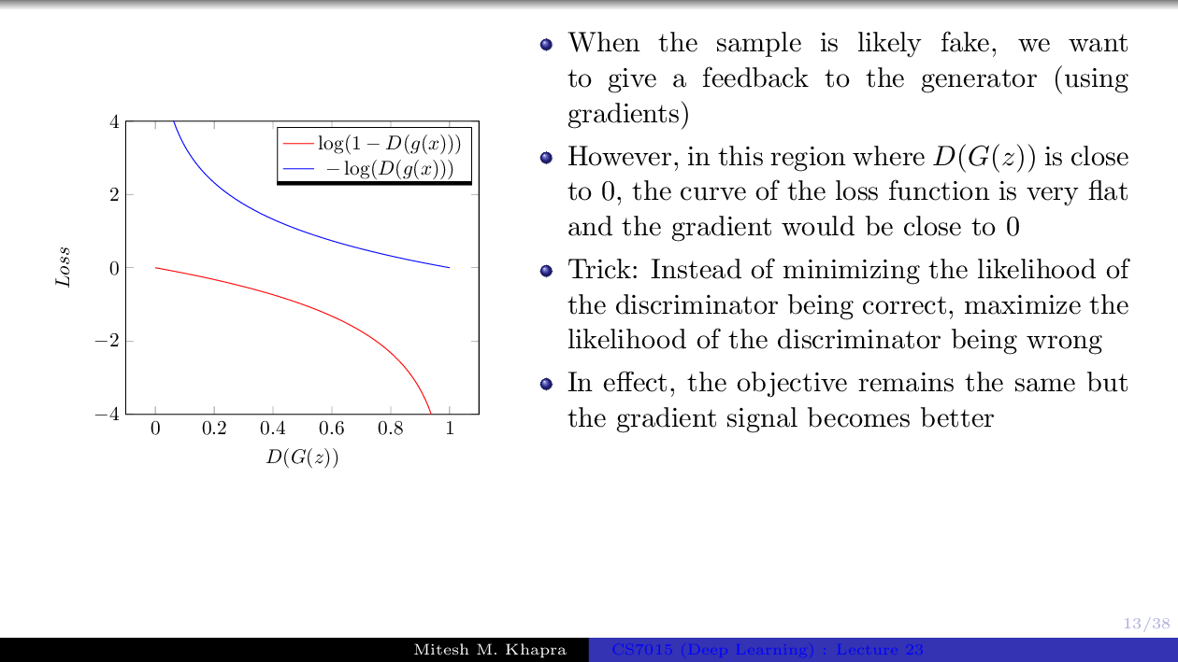

Slide 14
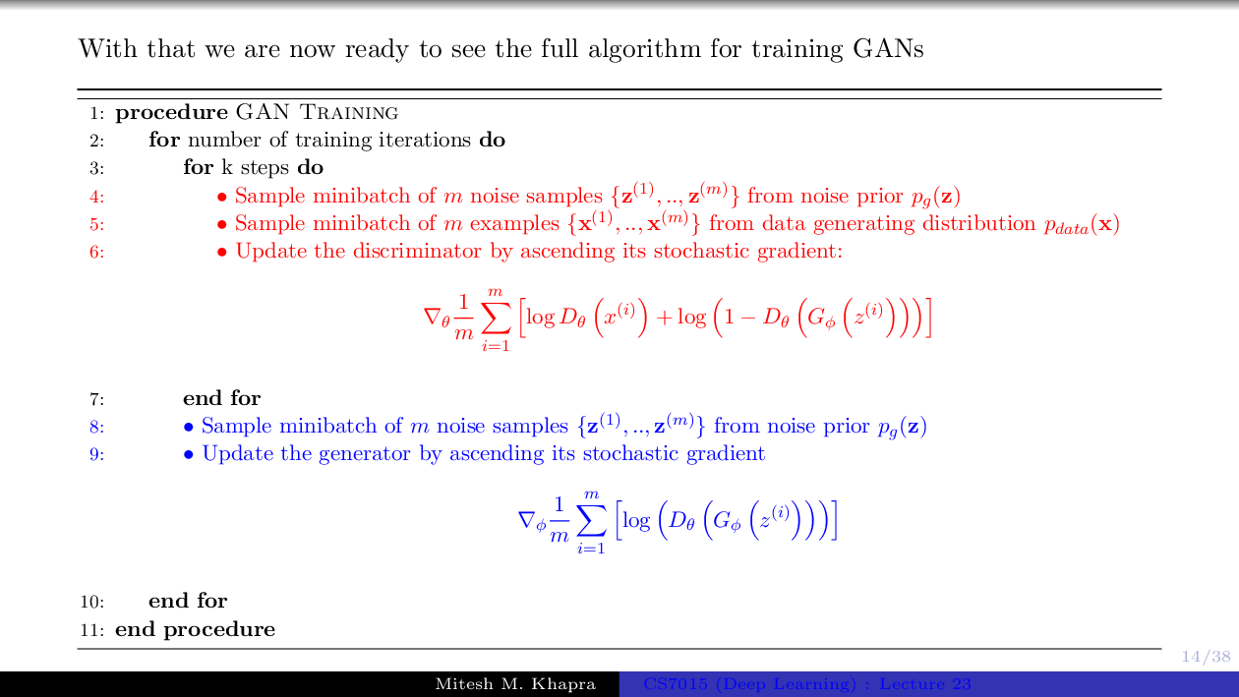

Slide 15
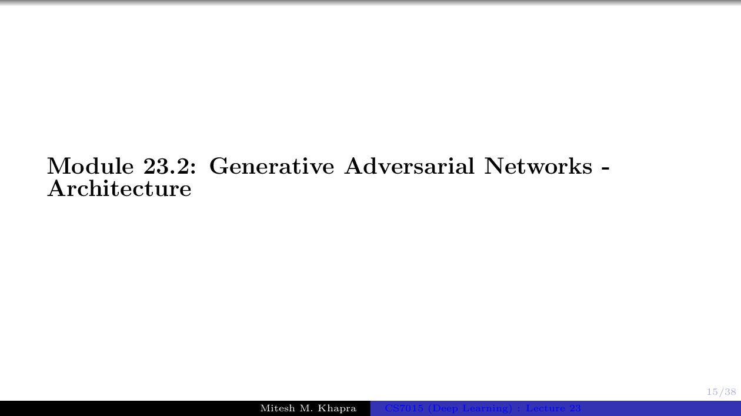

Slide 16
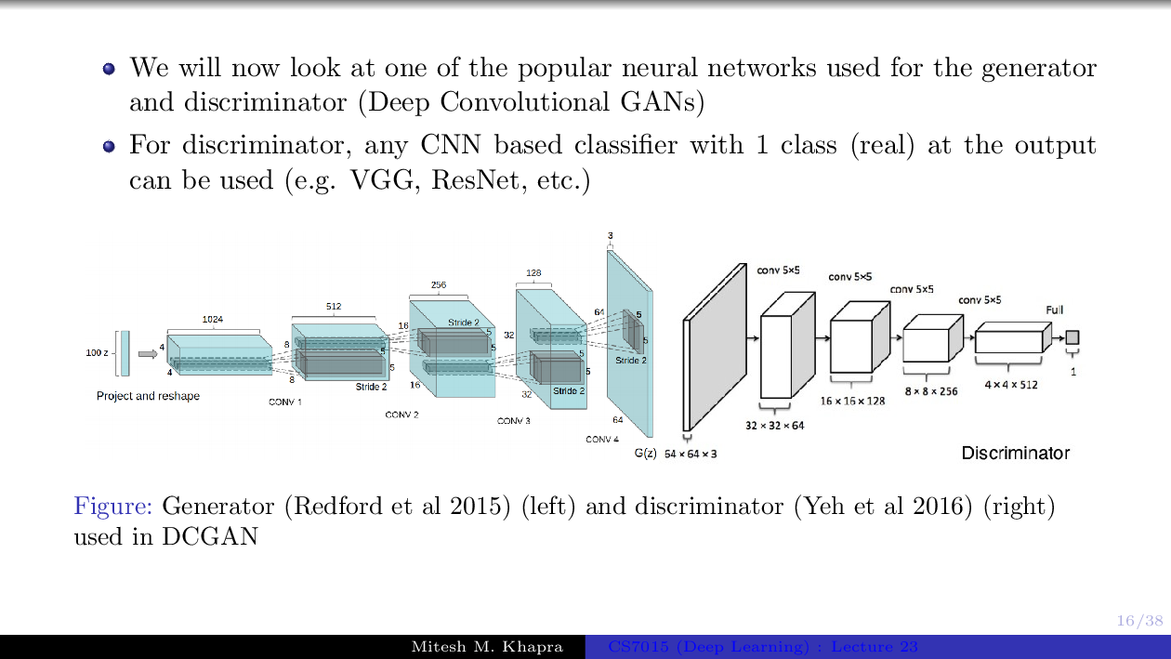

Slide 17
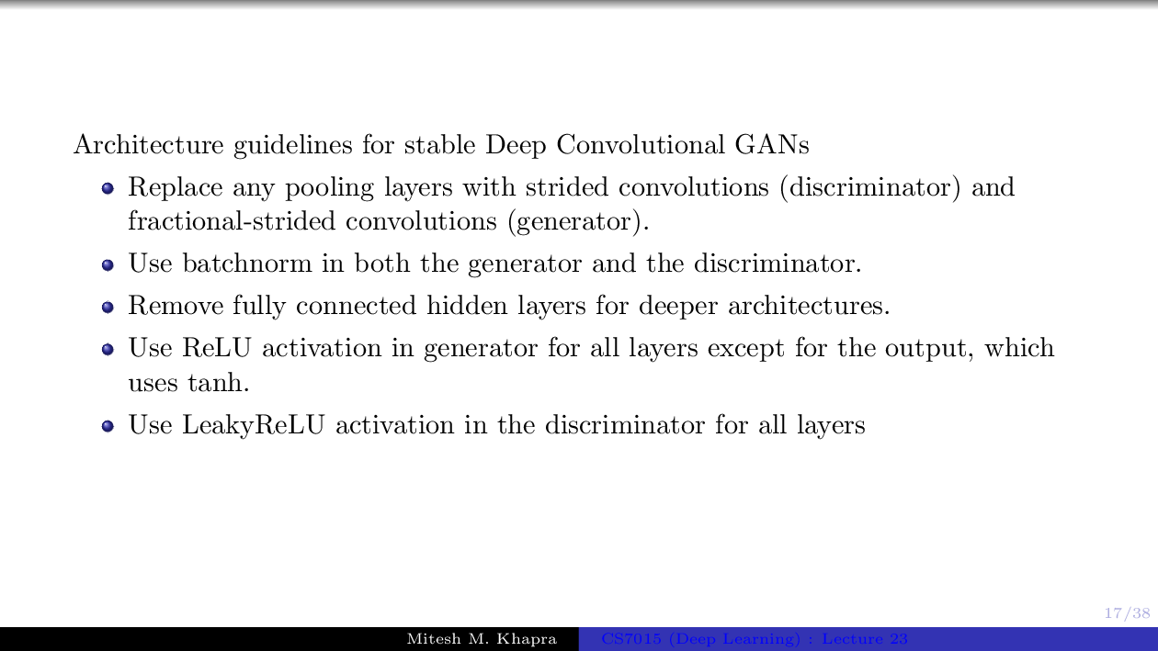

Slide 18
CycleGAN – Architecture
G
G: X -> Y
GAN (Y2X) loss
GAN (X2Y) loss
D_{X}
X
Y
D_{Y}
Cycle consistency loss
F: Y -> X
Cycle consistency loss
F
Notes:
cycleGAN is a variant of GAN that learns the translation/conversion between two sets of data source, these two sets of data source (they called two domains) do not correspond to each other.
The networks contain two generators and two discriminators.
The generator G translates an image in domain X to an image in domain Y.
The discriminator Dy determines whether the input is from domain Y or is generated by the generator G.
And vice versa the generator F and the discriminator Dx.
18

Slide 19



Cycle Consistency
EN
Obviously, we expected
EN -> G(EN) -> F(G(EN)) ~ EN
Formalized,
if G: X -> Y, F: Y -> X; expect,
X -> G(X) -> F(G(X)) ~ X
Translator G: English -> Chinese
CN
Cycle-consistency loss
CN
EN’
Translator F:
Chinese -> English
EN’
Notes:
19

Slide 20




CycleGAN – Objective Function
Full objective
Aim to solve
Adversarial loss (for G: X -> Y)
Cycle-consistency loss
Credit: https://arxiv.org/pdf/1703.10593.pdf
Notes:
Swapping X/x and Y/y can get the adversarial loss for F: Y -> X
Lgan(G, Dy, X, Y) – how much you can distinguish Y (an input) from the real Y and the generated Y with the discriminator Dy
Lgan(G, Dx, Y, X) – how much you can distinguish X (an input) from the real X and the generated X with the discriminator Dx
Lcyc(G, F) – distance between X and the re-constructed X (F(G(X))) + the distance between Y and the re-constructed Y (G(F(Y)))
20

Slide 21
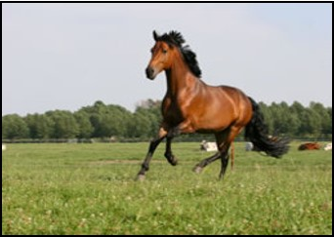
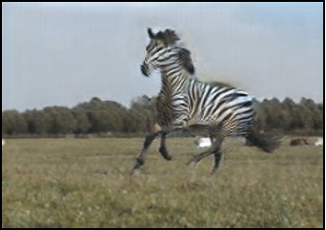
CycleGAN – Implement
encoding
transforming
decoding
Generator network
6 blocks for 128 x 128 images
c7s1-32, d64, d128, R128, R128, R128, R128, R128, R128, u64, u32, c7s1-3
9 blocks for 256 x 256 and higher resolution images
c7s1-32, d64, d128, R128, R128, R128, R128, R128, R128, R128, R128, R128, u64, u32, c7s1-3
Conv layer #1
Conv layer #2
Residual block #1
Residual block #2
Residual block #n
Conv layer #1
Conv layer #2
input
output
Notes:
C7s1-k denote a 7x7 Convolution-InstanceNorm-ReLU layer with k filters and stride 1.
Dk denotes a 3x3 Convolution-InstanceNorm-ReLU layer with k filters and stride 2.
Reflection padding was used to reduce artifacts.
Rk denotes a residual block that contains two 3x3 convolutional layers with the same number of filters on both layer.
Uk denotes a 3x3 Fractional-Strided-Convolution-InstanceNorm-ReLU layer with k filters and stride ½.
21

Slide 22
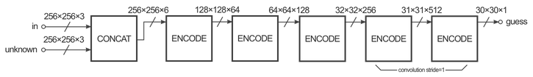
CycleGAN – Implementation
Discriminator network
70x70 PatchGAN
c64, c128, c256, c512
Credit: https://affinelayer.com/pix2pix/
Notes:
22

Slide 23
CycleGAN – Results
Applications
Analysis
Notes:
Check the paper
Images
Analysis
23

Slide 24
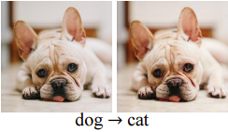
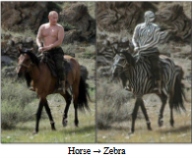
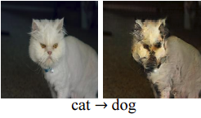
CycleGAN – Limitations
Changes in distribution characteristics (test set vs. training set)
Tasks require
geometric changes
A lingering gap between the results achievable from pix2pix and that achieved by CycleGAN.
https://qiita.com/itok_msi/items/b6b615bc28b1a720afd7#%E8%BF%BD%E5%8A%A0%E5%AE%9F%E9%A8%93%E7%B5%90%E6%9E%9C20170614%E8%BF%BD%E8%A8%987
Notes:
24

Slide 25
Unstability of NN
15

Slide 26

Intriguing properties of neural networks (Szegedy et al. December 2013):
Are neural networks stable?

Slide 27
Intriguing properties of neural networks (Szegedy et al. December 2013):
Are neural networks stable?
Problem formulation: Given (𝑥, 𝑐) solve
𝐌𝐢𝐧_{𝒓} 𝜀 ||r||_{𝟐} +p_{𝒄}(𝑥 + 𝑟) (simultaneously decrease p_{𝒄} and ||𝑟||_{𝟐})

Slide 28
Intriguing properties of neural networks (Szegedy et al. December 2013):
Are neural networks stable?
Problem formulation: Given (𝑥, 𝑐) solve
𝐌𝐢𝐧_{𝒓} 𝜀 ||r||_{𝟐} +p_{𝒄}(𝑥 + 𝑟) (simultaneously decrease p_{𝒄} and ||𝑟||_{𝟐})
This is the notion of an adversarial attack: The attack is successful if and only if
^{𝑥}𝒂𝒅𝒗 ^{:= 𝑥 + 𝒓}𝒐𝒑𝒕𝒊𝒎𝒂𝒍
changes the class of 𝑥.

Slide 29
Intriguing properties of neural networks (Szegedy et al. December 2013):
Are neural networks stable?
Problem formulation: Given (𝑥, 𝑐) solve
𝐌𝐢𝐧_{𝒓} 𝜀 ||r||_{𝟐} +p_{𝒄}(𝑥 + 𝑟) (simultaneously decrease p_{𝒄} and ||𝑟||_{𝟐})
This is the notion of an adversarial attack: The attack is successful if and only if
^{𝑥}𝒂𝒅𝒗 ^{:= 𝑥 + 𝒓}𝒐𝒑𝒕𝒊𝒎𝒂𝒍
changes the class of 𝑥.
The problem is solved by stochastic gradient descent

Slide 30
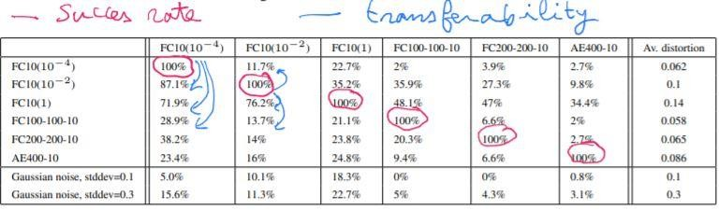
Intriguing properties of neural networks (Szegedy et al. December 2013):
Adversarial attacks as previously formulated are 100% successful. Adversarial examples constructed on one Neural network tend to be successful on other architectures Adversarial examples transfer well.

Slide 31
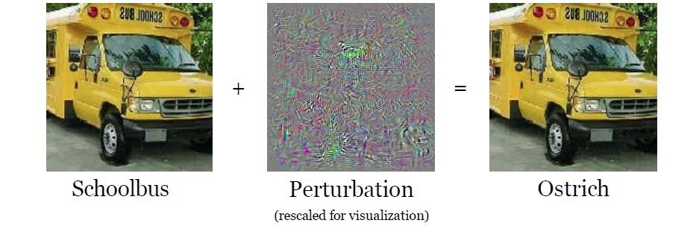
Intriguing properties of neural networks (Szegedy et al. December 2013): Results
Adversarial attacks as previously formulated are 100% successful. Adversarial examples constructed on one Neural network tend to be successful on other architectures Adversarial examples transfer well.
Adversarial examples are imperceptible to humans.

Slide 32
Explaining and Harnessing adversarial examples (Goodfellow et al. December 2014):
Adversarial attacks are much easier to construct: After training the network, for each (x,c), do one gradient step to decrease p_{𝒄} :
𝑥_{𝒂𝒅𝒗} := 𝑥 − 𝜖 ∙ sign ❑_{𝑥} p_{𝒄}(𝑥, 𝑊) (minimize p_{c} )

Slide 33
Explaining and Harnessing adversarial examples (Goodfellow et al. December 2014):
Adversarial attacks are much easier to construct: After training the network, for each (x,c), do one gradient step to decrease p_{𝒄} :
𝑥_{𝒂𝒅𝒗} := 𝑥 − 𝜖 ∙ sign ❑_{𝑥} p_{𝒄}(𝑥, 𝑊)
This method is called Fast gradient sign method: FGSM. It is 100% successful on IMAGENET even for small 𝜖.

Slide 34
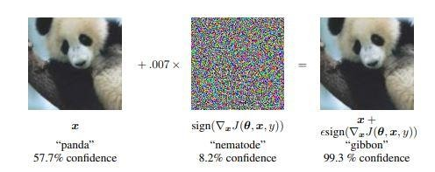
Explaining and Harnessing adversarial examples (Goodfellow et al. December 2014):
Adversarial attacks are much easier to construct: After training the network, for each (x,c), do one gradient step to decrease p_{𝒄} :
𝑥_{𝒂𝒅𝒗} := 𝑥 − 𝜖 ∙ sign ❑_{𝑥} p_{𝒄}(𝑥, 𝑊)
This method is called Fast gradient sign method: FGSM. It is 100% successful on IMAGENET even for small 𝜖.
The famous Panda example on IMAGENET:

Slide 35

A terminology related to attacks :
Distance metrics between 𝑥 and 𝑥_{𝑎𝑑𝑣}: 𝐷 𝑥, 𝑥_{𝑎𝑑𝑣}
𝐿₀ norm: the number of elements in 𝑥_{𝑎𝑑𝑣} such that 𝑥^{𝑖} ≠ 𝑥^{𝑖}
𝑎𝑑𝑣
𝐿₂ , 𝐿∞ norms

Slide 36
A terminology related to attacks :
Distance metrics between 𝑥 and 𝑥_{𝑎𝑑𝑣}: 𝐷 𝑥, 𝑥_{𝑎𝑑𝑣}
𝐿₀ norm: the number of elements in 𝑥_{𝑎𝑑𝑣} such that 𝑥^{𝑖} ≠ 𝑥^{𝑖}
𝑎𝑑𝑣
𝐿₂ , 𝐿∞ norms
Attack 1 is stronger than Attack 2 in the 𝑳_{𝒑} distance if it has more ability to generate successful 𝑥_{𝒂𝒅𝒗} Є B_{𝒑}(𝑥,𝜖)

Slide 37
A terminology related to attacks :
Distance metrics between 𝑥 and 𝑥_{𝑎𝑑𝑣}: 𝐷 𝑥, 𝑥_{𝑎𝑑𝑣}
𝐿₀ norm: the number of elements in 𝑥_{𝑎𝑑𝑣} such that 𝑥^{𝑖} ≠ 𝑥^{𝑖}
𝑎𝑑𝑣
𝐿₂ , 𝐿∞ norms
Attack 1 is stronger than Attack 2 in the 𝑳_{𝒑} distance if it has more ability to generate successful 𝑥_{𝒂𝒅𝒗} Є B_{𝒑}(𝑥,𝜖)
Attacks can be targeted or untargeted (the class of 𝑥_{𝑎𝑑𝑣} is given or not)

Slide 38
A terminology related to attacks :
Distance metrics between 𝑥 and 𝑥_{𝑎𝑑𝑣}: 𝐷 𝑥, 𝑥_{𝑎𝑑𝑣}
𝐿₀ norm: the number of elements in 𝑥_{𝑎𝑑𝑣} such that 𝑥^{𝑖} ≠ 𝑥^{𝑖}
𝑎𝑑𝑣
𝐿₂ , 𝐿∞ norms
Attack 1 is stronger than Attack 2 in the 𝑳_{𝒑} distance if it has more ability to generate successful 𝑥_{𝒂𝒅𝒗} Є B_{𝒑}(𝑥,𝜖)
Attacks can be targeted or untargeted (the class of 𝑥_{𝑎𝑑𝑣} is given or not)
What are the best attacks? Hope: The attack is unsuccessful is equivalent to the model is robust.

Slide 39
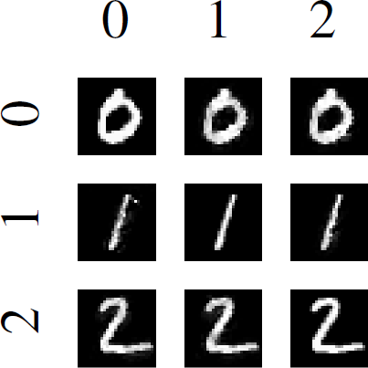
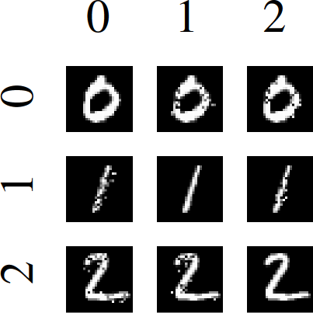
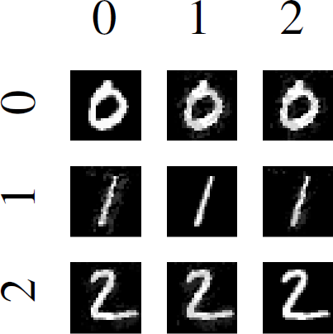
Towards Evaluating the Robustness of Neural Networks (Carlini et al. August 2016)
Carlini-Wagner (CW) attacks are the best 𝐿₀, 𝐿₂, 𝐿∞ attacks (in 2016). By considering the outputs of the last-to-one layer one can decrease/increase more efficiently p_{𝒄} .
𝐿₂ attacks are generated following Szegedy et al.
𝐿∞ and 𝐿₀ attacks are generated using approximations by differentiable functions of the
𝐿∞ and 𝐿₀ norms.
Examples of CW targeted attacks on MNIST:
𝐿∞ attack
𝐿₂ attack
𝐿₀ attack

Slide 40
Towards Deep Learning Models Resistant to Adversarial Attacks (Madry et al. June 2017)
Projected gradient descent (PGD) attack is an extension of FGSM, where after each step of perturbation, the adversarial example is projected back onto the 𝜖-ball of 𝑥 using a projection function Π
_{𝑥}𝑡
= Π_{𝗀} 𝑥^{𝑡−1} − 𝛼 ∙ sign ❑_{𝑥} p (𝑥^{𝑡−1}, 𝑊)
𝑎𝑑𝑣
𝒄

Slide 41
Towards Deep Learning Models Resistant to Adversarial Attacks (Madry et al. June 2017)
Projected gradient descent (PGD) attack is an extension of FGSM, where after each step of perturbation, the adversarial example is projected back onto the 𝜖-ball of 𝑥 using a projection function Π
_{𝑥}𝑡
= Π_{𝗀} 𝑥^{𝑡−1} − 𝛼 ∙ sign ❑_{𝑥} p (𝑥^{𝑡−1}, 𝑊)
𝑎𝑑𝑣
𝒄
PGD is regarded as the strongest 𝐿∞attack

Slide 42
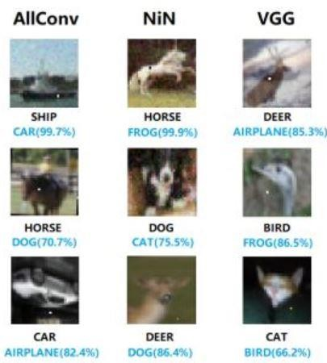
One Pixel Attack for Fooling Deep Neural Networks (Su et al. October
2017)
One pixel attacks are more spectacular: only one pixel is allowed to be changed.
Inspired from genetic algorithms:
Randomly fix candidate pixels {𝑋_{𝑖}}
Mutate each 𝑋_{𝑖} as follows: mutation(𝑋_{𝑖})= 𝑋_{𝑖}+𝜆(𝑋_{𝑘}-𝑋_{𝑙})
(k and l are random candidate indices)
Choose between 𝑋_{𝑖} and mutation(𝑋_{𝑖}) according to which pixel decreases the most the current probability.

Slide 43
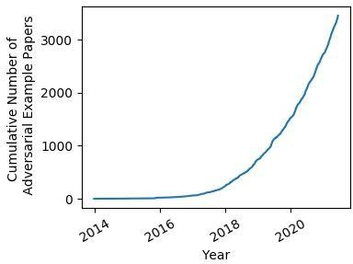
Adversarial attacks papers

Slide 44
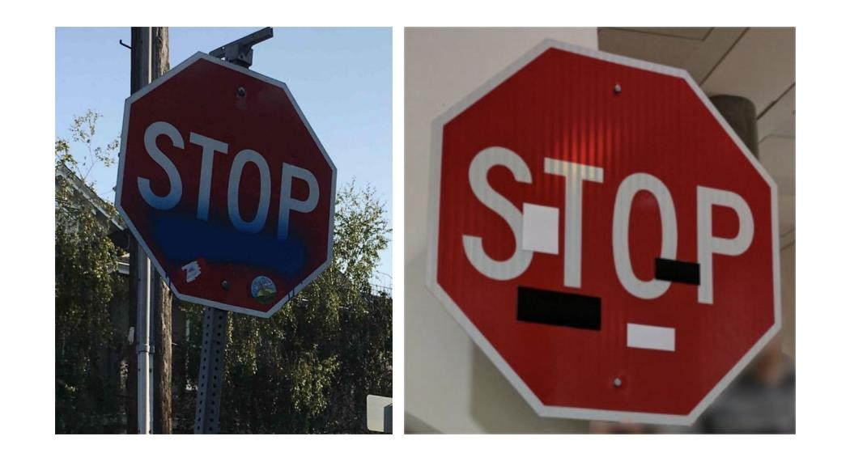
Key takeaways:
CW, PGD are the most powerful attacks. There has been very slight improvements since then.
𝐿₀, 𝐿₂, 𝐿∞ are generally imperceptible.
More perceptible attacks have also been studied: e.g. attacks by adding foreign objects (patches,
stickers), by changing the background of the image (semantic) etc.
An attack by adding stickers: picture from Robust physical world attacks on deep learning models

